Slide 1


Slide 2

26
AGGREGATE SUPPLY AND AGGREGATE DEMAND

Slide 3
After studying this chapter, you will be able to:
Explain what determines aggregate supply
Explain what determines aggregate demand
Explain what determines real GDP and the price level and how economic growth, inflation, and the business cycle arise
Describe the main schools of thought in macroeconomics today

Slide 4
Aggregate Supply
  Quantity Supplied and Supply
  The quantity of real GDP supplied is the total quantity that firms plan to produce during a given period.
  Aggregate supply is the relationship between the quantity of real GDP supplied and the price level.
  We distinguish two time frames associated with different states of the labour market:
  (I) Long-run aggregate supply
  (II) Short-run aggregate supply

Slide 5
Aggregate Supply
Long-Run Aggregate Supply
  Long-run aggregate supply is the relationship between the quantity of real GDP supplied and the price level when real GDP equals potential GDP.
  Potential GDP is independent of the price level.
  (meaning Potential GDP does NOT depend on the price level)
  So the long-run aggregate supply curve (LAS) is vertical at potential GDP.

Slide 6
Aggregate Supply
Short-Run Aggregate Supply
  Short-run aggregate supply is the relationship between the quantity of real GDP supplied and the price level when the money wage rate, the prices of other resources, and potential GDP remain constant.
  A rise in the price level with no change in the money wage rate and other factor prices increases the quantity of real GDP supplied. (total revenue increases and the cost of the labour is the same, with this incentive, firms will produce more)
  The short-run aggregate supply curve (SAS) is upward sloping.

Slide 7
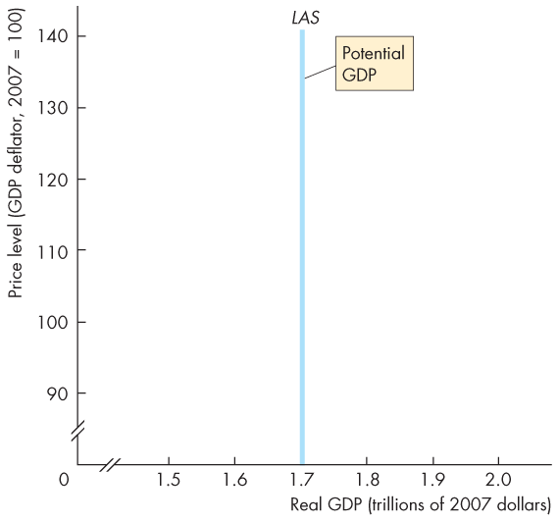
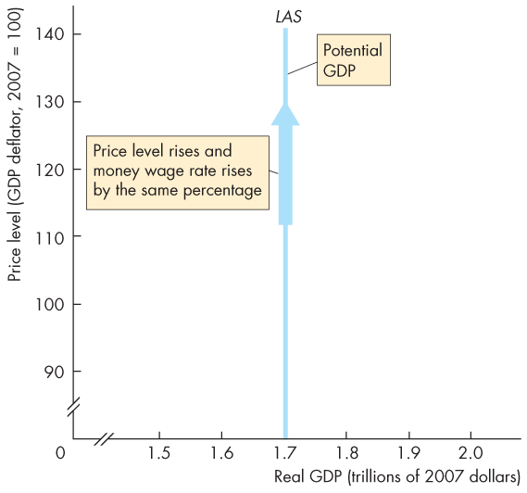
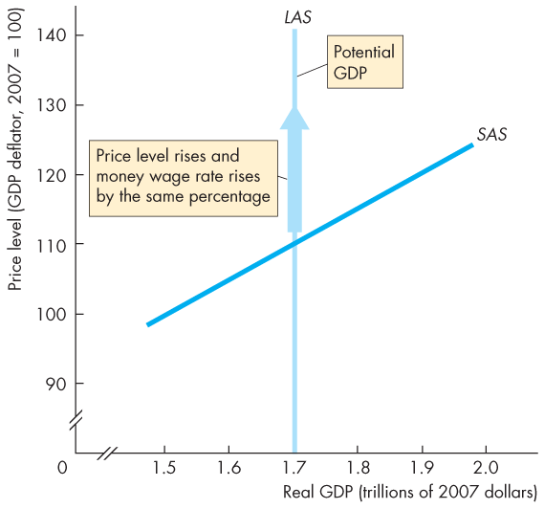
Aggregate Supply
  Figure 26.1 shows the LAS curve.
  In the long run, the quantity of real GDP supplied is potential GDP.
  As the price level rises and the money wage rate changes by the same percentage, the quantity of real GDP supplied remains at potential GDP.

Slide 8

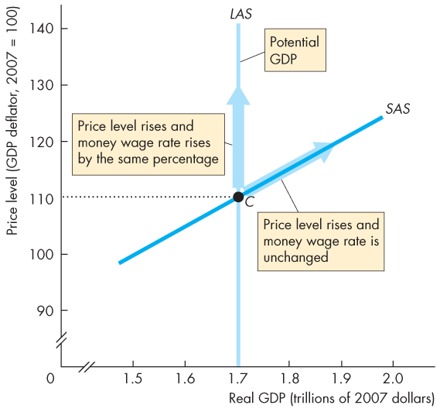
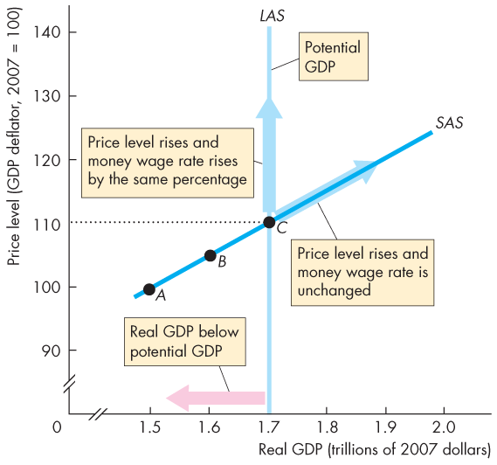
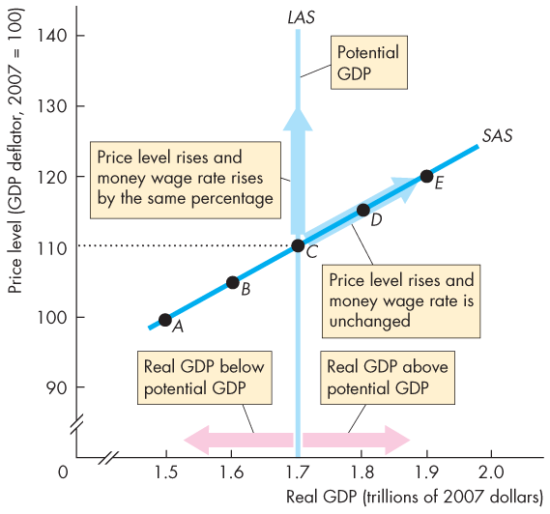

Slide 9
Aggregate Supply
  In the short run, the quantity of real GDP supplied increases if the price level rises.
  The SAS curve slopes upward.
  A rise in the price level with no change in the money wage rate induces firms to increase production.

Slide 10
Aggregate Supply
  With a given money wage rate, the SAS curve cuts the LAS curve at potential GDP.
  The price level is 110.
  (II) With the given money wage rate, as the price level falls below 110 ...
  the quantity of real GDP supplied decreases along the SAS curve.

Slide 11
Aggregate Supply
  With the given money wage rate, as the _{price level rises} above 110 …
  the quantity of real GDP supplied increases along the SAS curve.
  Real GDP exceeds potential GDP.
  Note: A change in the price level is movement along the SAS curve

Slide 12
Aggregate Supply
Changes in Aggregate Supply
(What will shift Aggregate Supply?)
  Aggregate supply changes if an influence on production plans other than the price level changes.
  These influences include
  1. Changes in potential GDP
  2. Changes in money wage rate (and other factor prices)

Slide 13
Aggregate Supply
1. Changes in Potential GDP
  When potential GDP increases, both the LAS and SAS curves shift rightward.
  Potential GDP increases if: (more factors of production)
  Potential GDP: the quantity of real GDP at full employment
  The full-employment quantity of labour increases
  The quantity of capital (physical or human) increases
  An advance in technology occurs

Slide 14
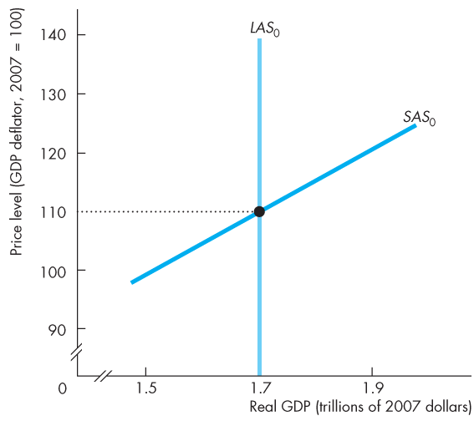
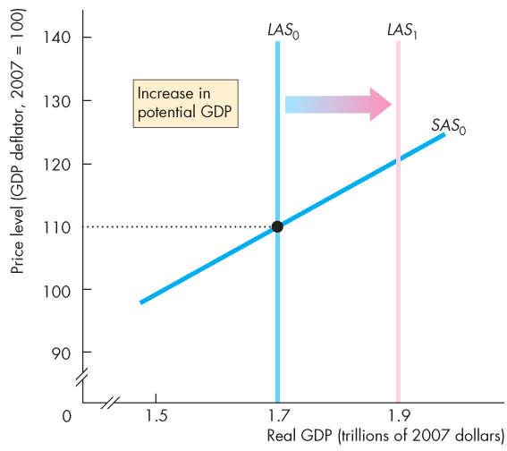
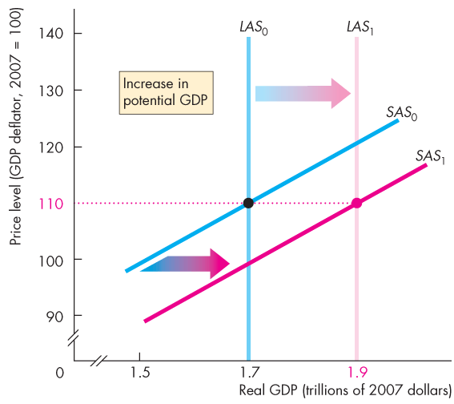
Aggregate Supply
  Figure 26.2 shows the effect of an increase in potential GDP.
  The LAS curve shifts rightward and the SAS curve shifts along with the LAS curve.
  Increase both long run and short run, but the price level doesn’t change

Slide 16
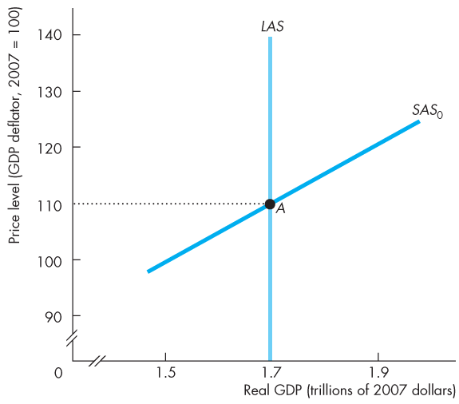
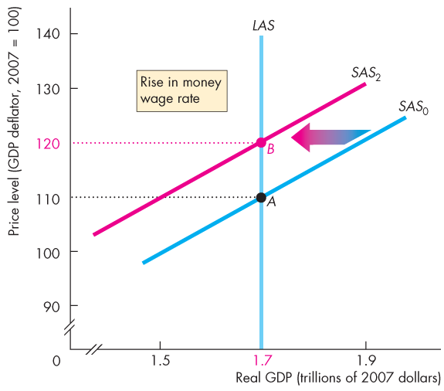
Aggregate Supply
  Changes in the Money Wage Rate
  Figure 26.3 shows the effect of a rise in the money wage rate.
  Short-run aggregate supply decreases and the SAS curve shifts leftward.
  Long-run aggregate supply does not change.

Slide 18
Aggregate Demand
  The quantity of real GDP demanded, Y, is the total amount of final goods and services produced in Canada that people (consumption), businesses (investment), governments (government consumption), and foreigners (exports) plan to buy.
  This quantity is the sum of consumption expenditures, C, investment, I, government expenditure, G, and net exports, X – M.
  That is,
  Y = C + I + G + X – M.

Slide 19
Aggregate Demand
  Buying plans depend on many factors and some of the main ones are
  The price level
  Expectations
  Fiscal policy and monetary policy
  The world economy
  Movement along the curve:
  Shifts the curve

Slide 20
Aggregate Demand
The Aggregate Demand Curve
  Aggregate demand is the relationship between the quantity of real GDP demanded and the price level.
  The aggregate demand curve (AD) plots the quantity of real GDP demanded against the price level.

Slide 21
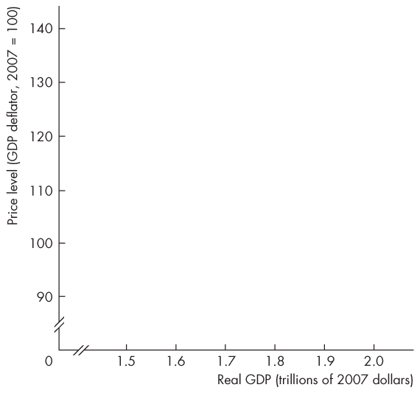
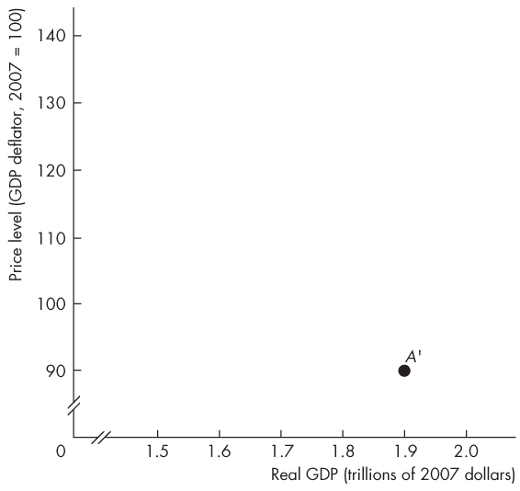
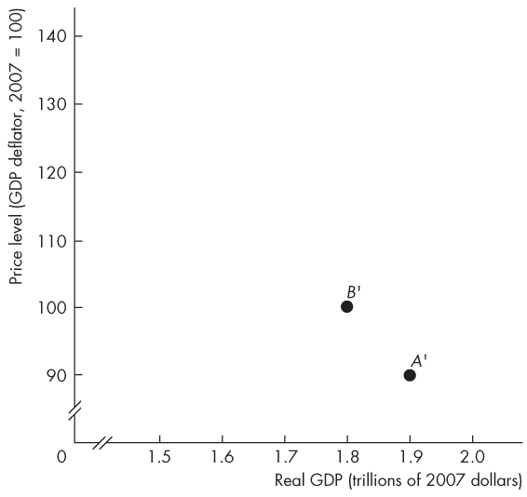
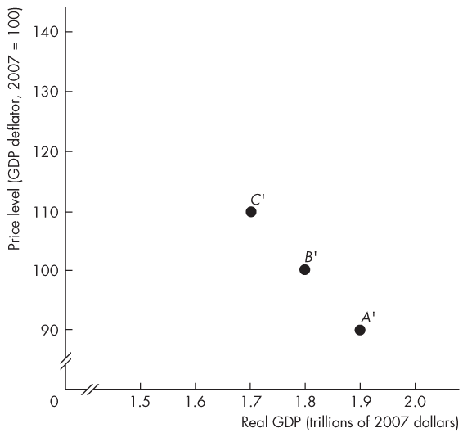
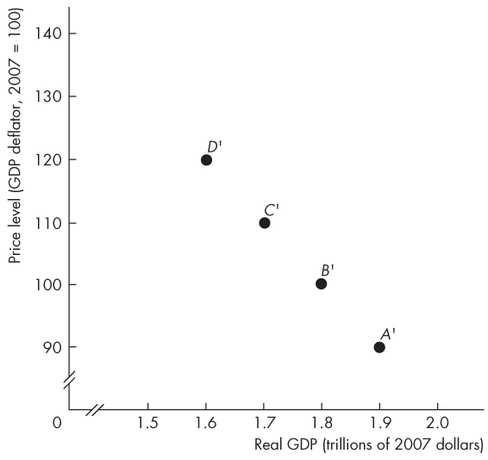
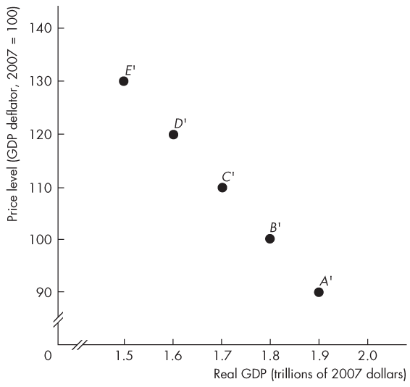
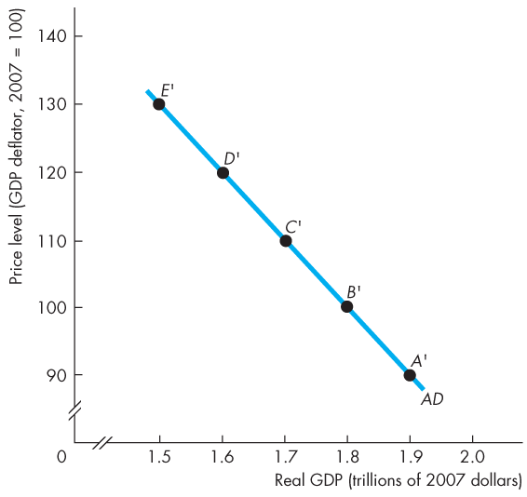

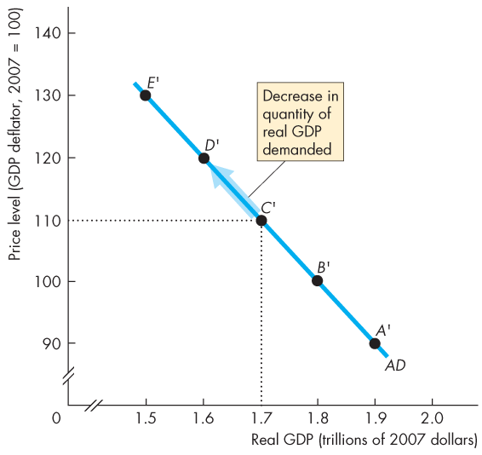
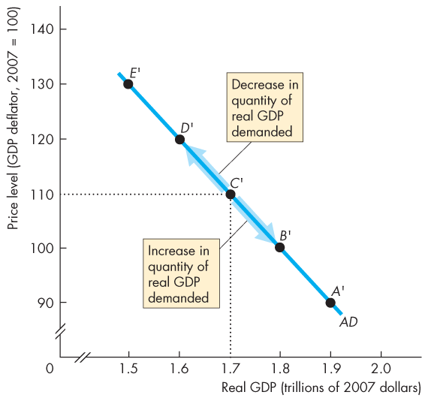
Aggregate Demand
  Figure 26.4 shows an AD curve.
  The AD curve slopes downward for two reasons (meaning: there is an inverse relationship between the price level and quantity demanded) :
  1. Wealth effect (consumption decisions)
  2. Substitution effects

Slide 23
Aggregate Demand
  1. Wealth Effect (P increases, T decreases)
  A rise in the price level, other things remaining the same, decreases the quantity of real wealth (money, stocks, etc.).
  To restore their real wealth, people increase saving and decrease spending.
  The quantity of real GDP demanded decreases.
  Similarly, a fall in the price level, other things remaining the same, increases the quantity of real wealth and increases the quantity of real GDP demanded increases. (P decreases, T increases)

Slide 24
Aggregate Demand
  Substitution Effects
  Intertemporal substitution effect:
  A rise in the price level, other things remaining the same, decreases the real value of money and raises the interest rate.
  When the interest rate rises, people borrow and spend less, so the quantity of real GDP demanded decreases.
  Similarly, a fall in the price level increases the real value of money and lowers the interest rate.
  When the interest rate falls, people borrow and spend more, so the quantity of real GDP demanded increases.
meaning:across time
increasing P decreasingM/P increasing IR decreasing I decreasing Y
decreasing P decresing M/P 跟上面的反一下

Slide 25
Aggregate Demand
  International substitution effect:
  A rise in the price level, other things remaining the same, increases the price of domestic goods relative to foreign goods.
  So imports increase and exports decrease, which decreases the quantity of real GDP demanded.
  Similarly, a fall in the price level, other things remaining the same, increases the quantity of real GDP demanded.
incressing P p>p* decreasing export decreasing (X-M) decreasing Y

Slide 26
Aggregate Demand
what will shift the aggregate demand curve?
Changes in Aggregate Demand
  A change in any influence on buying plans other than the price level changes aggregate demand.
  The main influences on aggregate demand are
  Expectations
  Fiscal policy and monetary policy
  The world economy
shift the curve
list from slide 19

Slide 27
Aggregate Demand
  Expectations
  Expectations about future income, future inflation, and future profits change aggregate demand.
  Increases in expected future income increase people’s consumption today and increases aggregate demand.
  A rise in the expected inflation rate makes buying goods cheaper today and increases aggregate demand.
  (if we think the price will go up next year, we will probably buy something this year)
  An increase in expected future profits boosts firms’ investment, which increases aggregate demand.

Slide 28
Aggregate Demand
Fiscal Policy and Monetary Policy
  Fiscal policy is the government’s attempt to influence the economy by setting and changing taxes, making transfer payments, and purchasing goods and services.
  A tax cut or an increase in transfer payments increases households’ disposable income—aggregate income minus taxes plus transfer payments. (Y-T) + transfer
  An increase in disposable income increases consumption expenditure and increases aggregate demand.

Slide 29
Aggregate Demand
  Fiscal Policy and Monetary Policy
  Because government expenditure on goods and services is one component of aggregate demand, an increase in government expenditure increases aggregate demand.
  Monetary policy is changes in interest rates and the quantity of money in the economy.
  An increase in the quantity of money increases buying power and increases aggregate demand.
  A cut in interest rates increases expenditure and increases aggregate demand. decreasing IR increasing I increasing Y

Slide 30
Aggregate Demand
The World Economy
  The world economy influences aggregate demand in two ways:
  A fall in the foreign exchange rate lowers the price of domestic goods and services relative to foreign goods and services, which increases exports, decreases imports, and increases aggregate demand.
  An increase in foreign income increases the demand for Canadian exports and increases aggregate demand.

Slide 31
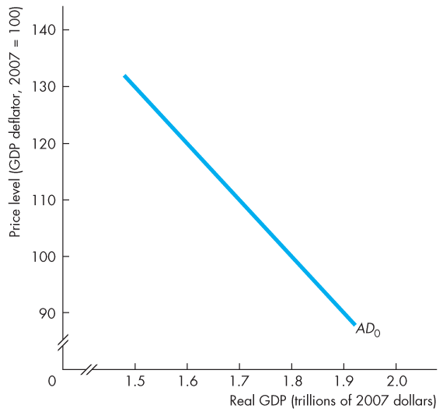
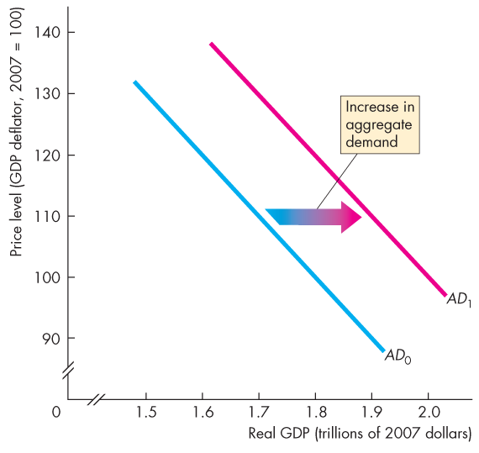
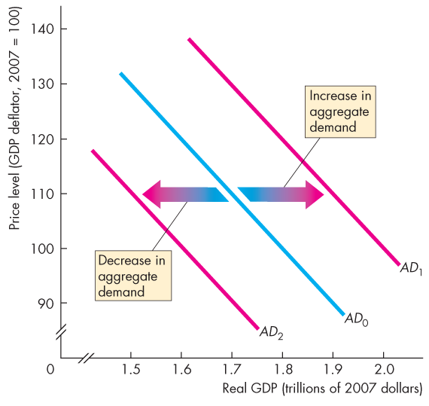
Aggregate Demand
  Figure 26.5 illustrates changes in aggregate demand.
  When aggregate demand increases, the AD curve shifts rightward …
  … and when aggregate demand decreases, the AD curve shifts leftward.

Slide 33
Aggregate Demand
Aggregate demand Increases if:
1. Expected future income , inflation, or profit incresses
.2.Fiscal policy increses governmnent expenditure (G), decreses taxex, or increses transfer payments
3. Monetary polici increses the quantity of money and decreses interest rates
4. the exchange rate decreses or foreign incone increses

Slide 34
Aggregate demand Decreses if:
1. Expected future income , inflation, or profit decresses
.2.Fiscal policydecreases governmnent expenditure (G), increases taxex, or decreases transfer payments
3. Monetary policy increases the quantity of money and increases interest rates
4. the exchange rate increases or foreign incone decreases

Slide 35
Explaining Macroeconomic Trends and Fluctuations
Short-Run Macroeconomic Equilibrium
  Short-run macroeconomic equilibrium occurs when the quantity of real GDP demanded equals the quantity of real GDP supplied at the point of intersection of the AD curve and the SAS curve.

Slide 36
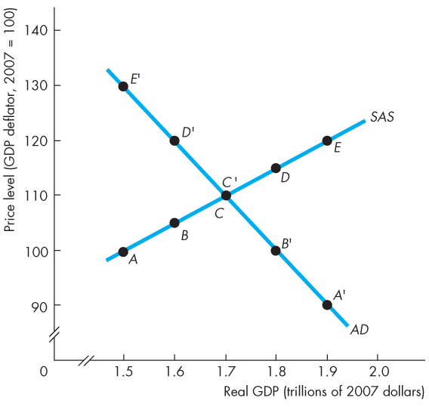
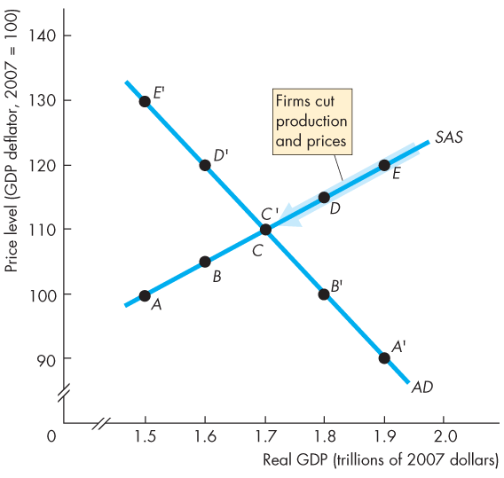
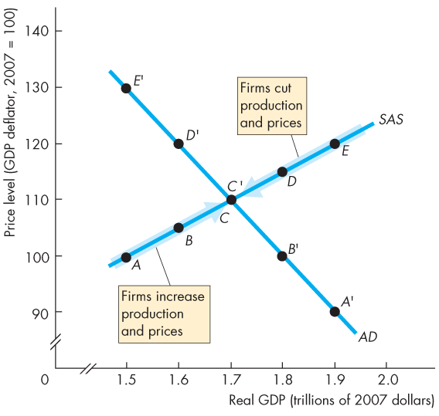
Explaining Macroeconomic Trends and Fluctuations
  Figure 26.6 illustrates a short-run equilibrium.
  If real GDP is above equilibrium GDP, firms decrease production and lower prices…
  … and if real GDP is below equilibrium GDP, firms increase production and raise prices.

Slide 37
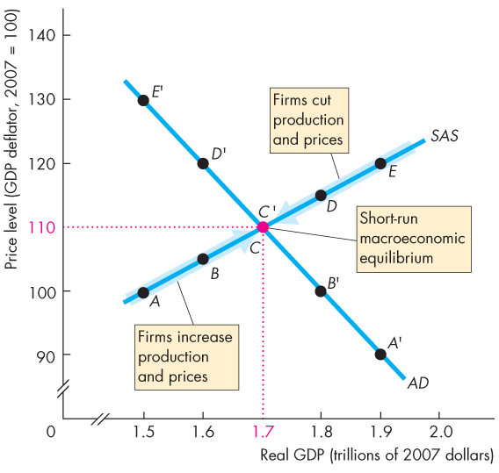

Slide 38
Explaining Macroeconomic Trends and Fluctuations
  These changes bring a movement along the SAS curve towards equilibrium.
  In short-run equilibrium, real GDP can be greater than or less than potential GDP.
  recall: in the short run, the money wage rate is fixed

Slide 39
Explaining Macroeconomic Trends and Fluctuations
Long-Run Macroeconomic Equilibrium
  Long-run macroeconomic equilibrium occurs when real GDP equals potential GDP—when the economy is on its LAS curve.
  Long-run equilibrium occurs at the intersection of the AD and LAS curves.

Slide 40
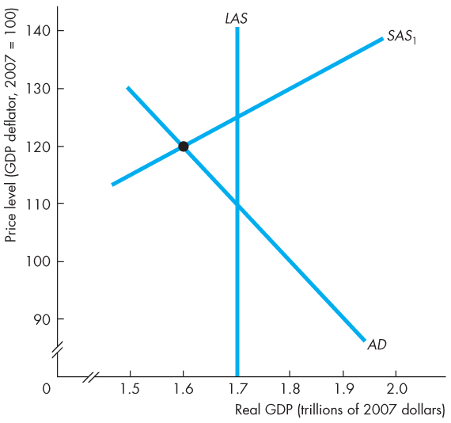
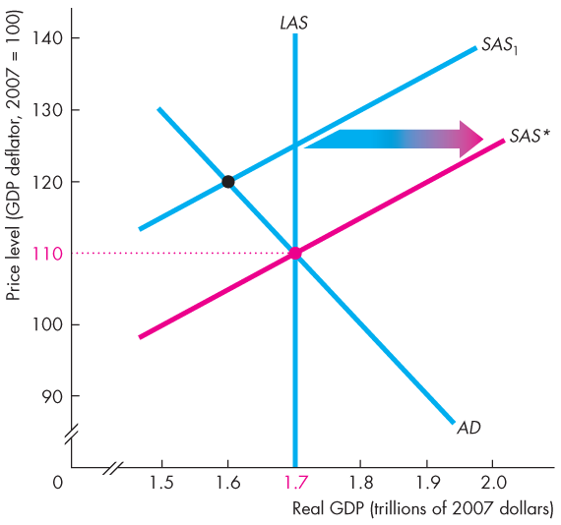
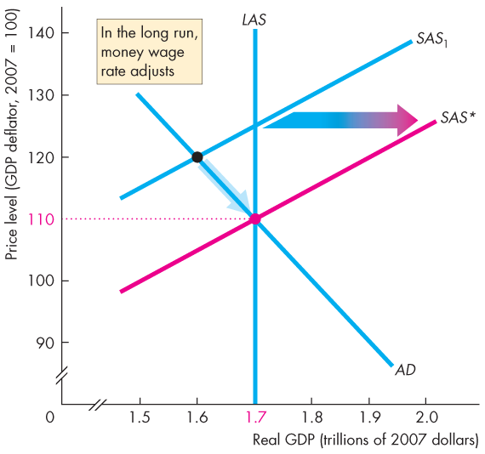
Explaining Macroeconomic Trends and Fluctuations
  Figure 26.7 illustrates the adjustment to long-run equilibrium.
  Initially, the economy is at below-full employment equilibrium.(below potential)
  In the long run, the money wage falls until the SAS curve passes through the long-run equilibrium point.

Slide 41
transition to long-run equilibrium
wages have to shift down
real GDP

Slide 42
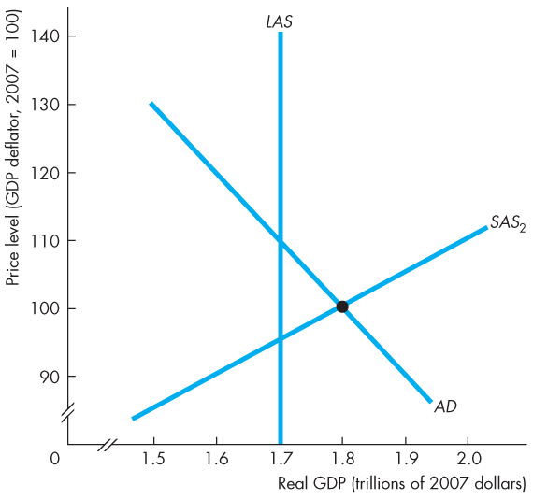
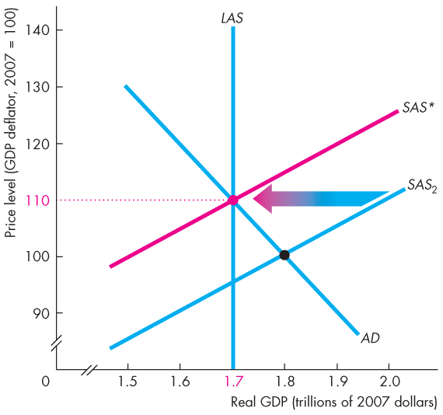
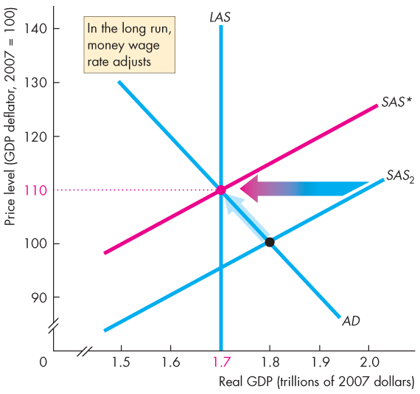
Explaining Macroeconomic Trends and Fluctuations
  Initially, the economy is at an above-full employment equilibrium.
  In the long run, the money wage rises until the SAS curve passes through the long-run equilibrium point.

Slide 43
potential GDp
that poing: real GDP

Slide 44
Transition to Long-run Equilibrium
In long-run equlibrium, Real GDP= Potential GDP
if real gdp not equal to potential gdp, the money wage adjusts.
(a) if the money wage is too high:
Short-run equilibrium is below potential GDP
Unployment rate is high
supply of labour.demand for labour
Money wage rate falls
SAS shifts rightward
(b) if the money wage is too low
short-run equilibrium is above potential GDP
unemployment rate is low
demand of labour.supply of labour
Money wage rate rises
SAS shifts leftward

Slide 45
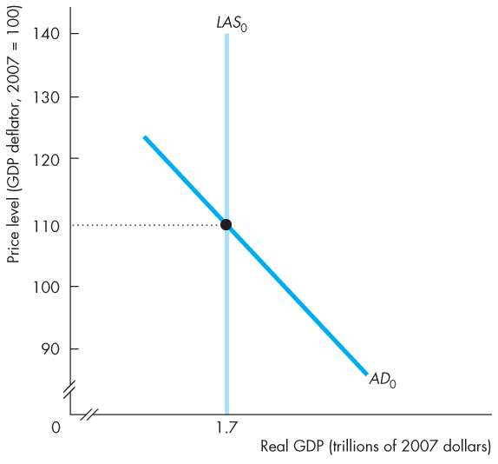
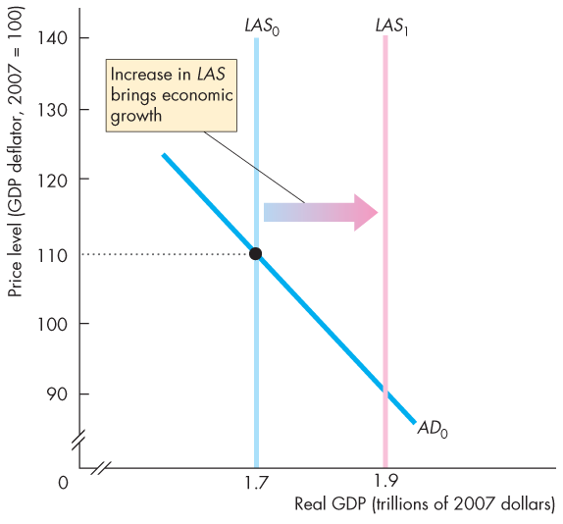
Explaining Macroeconomic Trends and Fluctuations
Economic Growth in the AS-AD Model
  Figure 26.8 illustrates economic growth.
  Because the quantity of labour grows, capital is accumulated, and technology advances, potential GDP increases.
  The LAS curve shifts rightward.

Slide 46
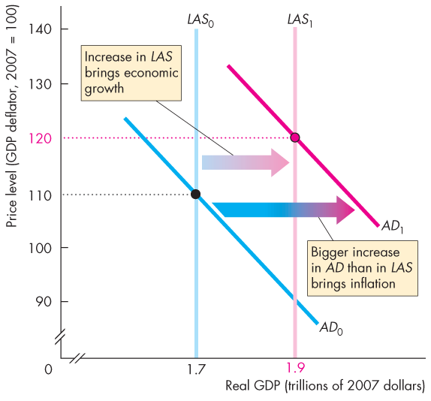
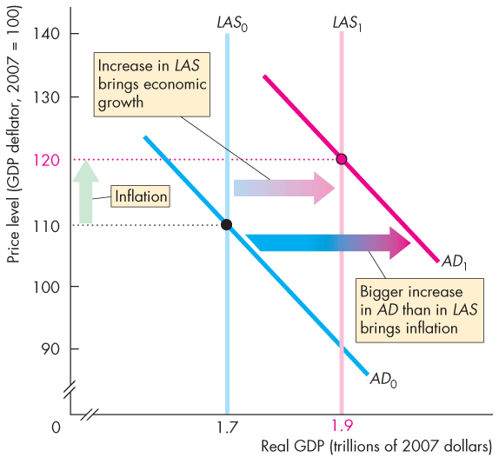
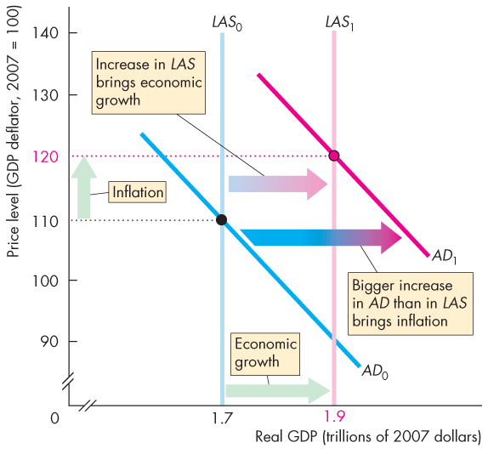
Explaining Macroeconomic Trends and Fluctuations
  Figure 26.8 also illustrates inflation.
  If the quantity of money grows faster than potential GDP, aggregate demand increases by more than long-run aggregate supply.
  The AD curve shifts rightward faster than the rightward shift of the LAS curve.

Slide 47
An increse in the quantity of money (shifts AD) in excess of the increse in potential GDP in inflationary

Slide 48
Quantity Theory of Money
% M+ % V=% P+% Y
growht rate inflation economic growth
of money
supply
solve for % P inflation
% P=% M- % Y

Slide 49
Explaining Macroeconomic Trends and Fluctuations
The Business Cycle in the AS-AD Model
  The business cycle occurs because aggregate demand and the short-run aggregate supply fluctuate, but the money wage does not change rapidly enough to keep real GDP at potential GDP.
  An above full-employment equilibrium is an equilibrium in which real GDP exceeds potential GDP.
  A full-employment equilibrium is an equilibrium in which real GDP equals potential GDP.
  A below full-employment equilibrium is an equilibrium in which potential GDP exceeds real GDP.

Slide 50
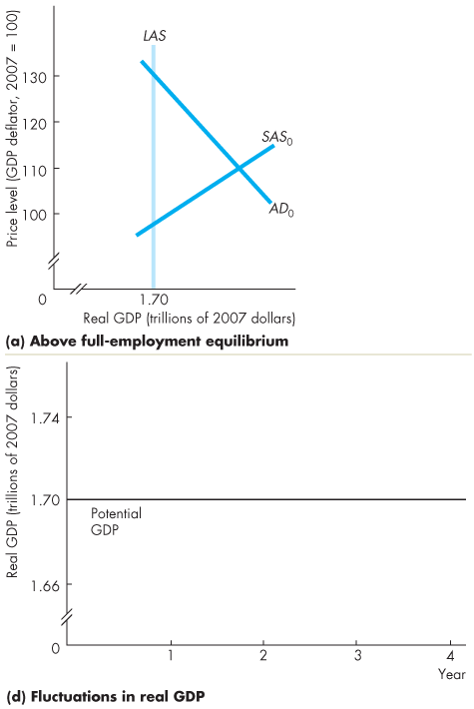
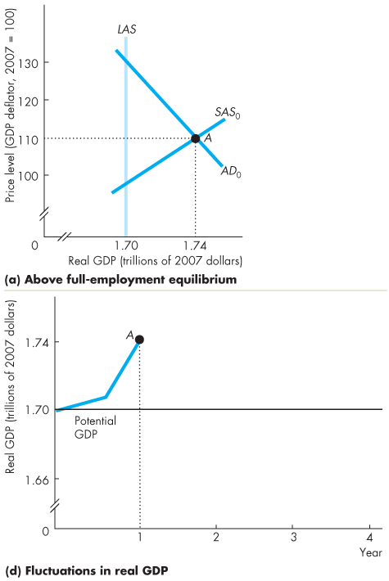
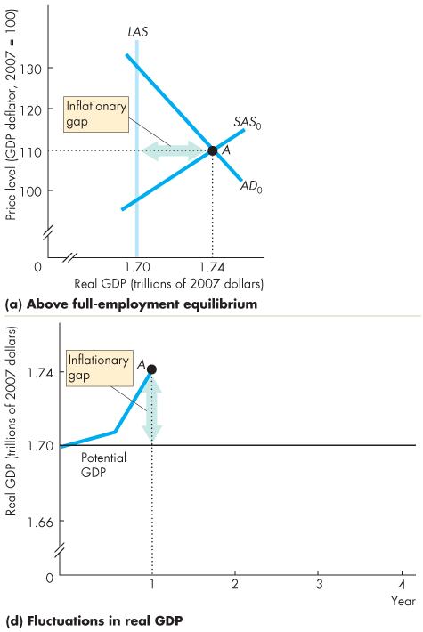
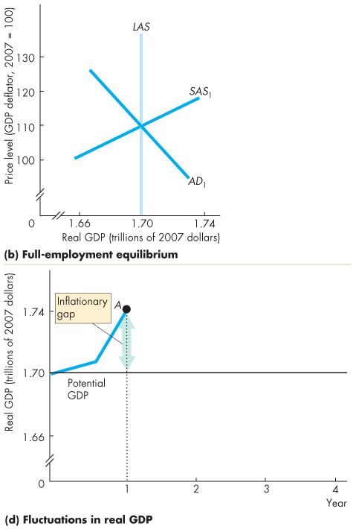
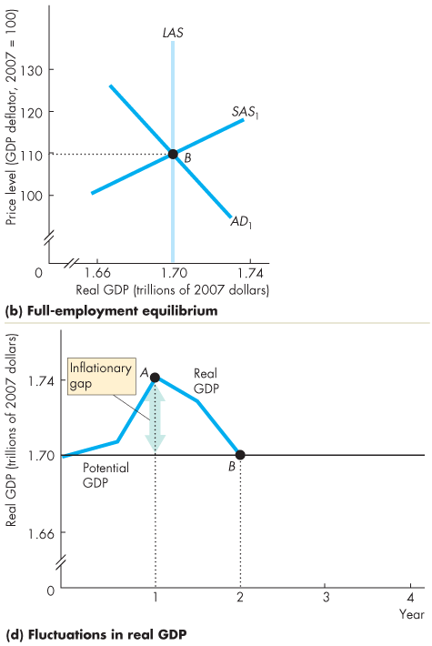
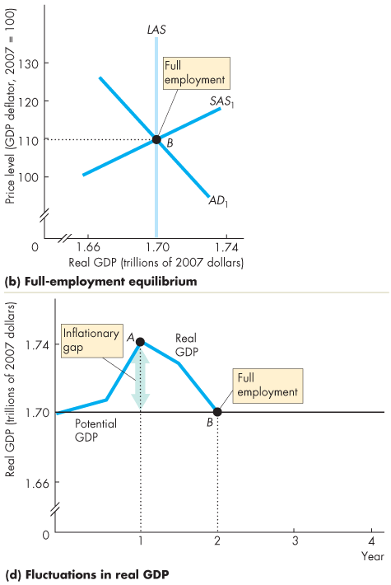
Explaining Macroeconomic Trends and Fluctuations
  Figures 26.9(a) and (d) illustrate above full-employment equilibrium.
  The amount by which potential GDP exceeds real GDP is called a inflationary gap.
  Figures 26.9(b) and (d) illustrate full-employment equilibrium.
  case2： case1我看了下好像是图反了，是case 3e'd

Slide 51
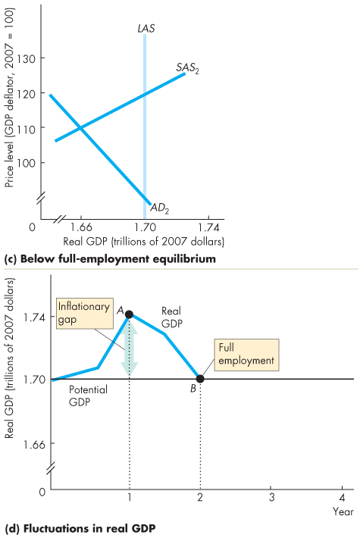
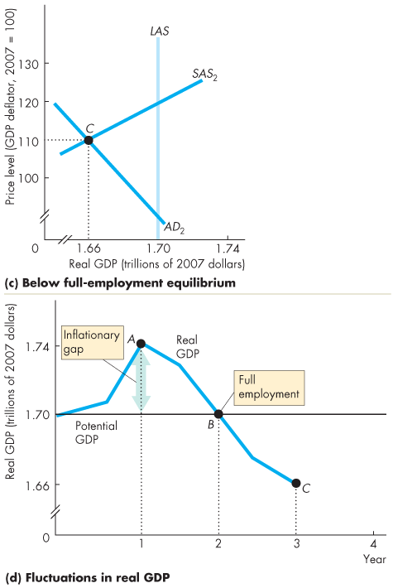
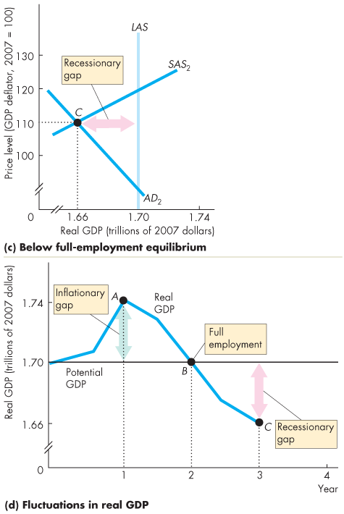
case3 ca's

Slide 52
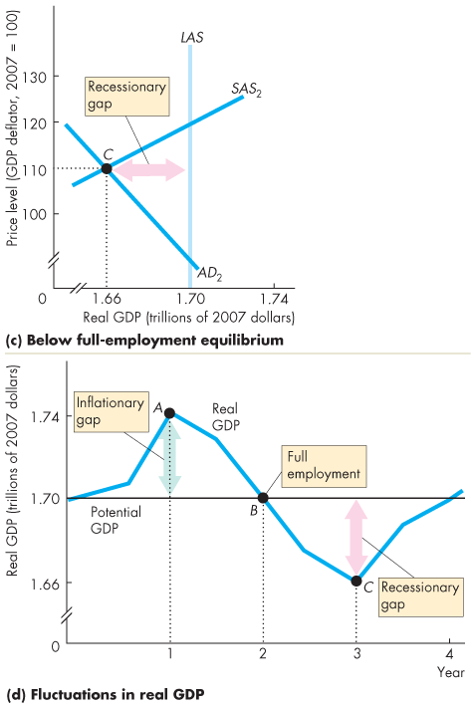
Explaining Macroeconomic Trends and Fluctuations
  Figures 26.9(c) and (d)
  illustrate below full-employment equilibrium.
  When real GDP is less than potential GDP, the gap is called a recessionary gap.
  Figure 26.9(d) shows how, as the economy moves from one type of short-run equilibrium to another, real GDP fluctuates around potential GDP in a business cycle.

Slide 53
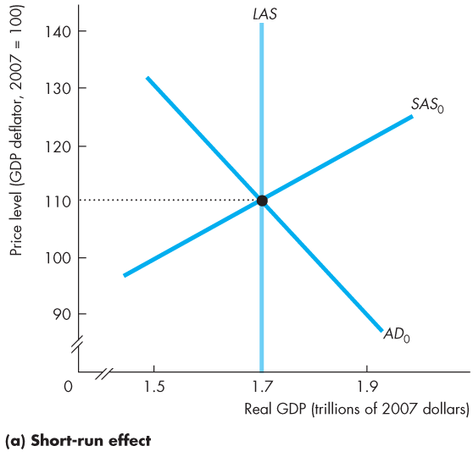
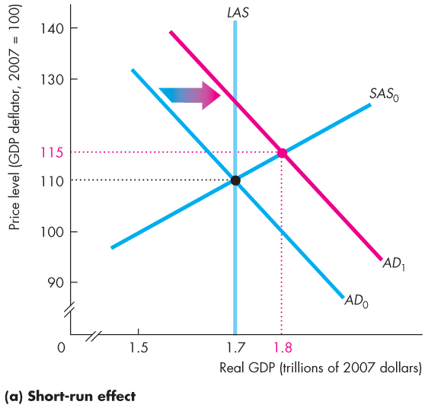
Explaining Macroeconomic Trends and Fluctuations
causes of fluctuation in the short run
Fluctuations in Aggregate Demand
  Figure 26.10 shows the effects of an increase in aggregate demand.
  An increase in aggregate demand shifts the AD curve rightward.
  Firms increase production and the price level rises in the short run.

Slide 54
inflationary gap
(slide 46)
how do we make the adjustment tothe long-run equilibrium

Slide 55





Explaining Macroeconomic Trends and Fluctuations
  At the short-run equilibrium, there is an inflationary gap.
  The money wage rate begins to rise and the SAS curve starts to shift leftward.
  The price level continues to rise and real GDP continues to decrease until it equals potential GDP.

Slide 56
Adjustment:
-money wage increases
- SAS shifts left
- Price level increases
- real GDP decreases until it equal s thpotential

Slide 57


Explaining Macroeconomic Trends and Fluctuations
Fluctuations in Aggregate Supply
  Figure 26.11 shows the effects of a rise in the price of oil.
  The SAS curve shifts leftward.
  Real GDP decreases and the price level rises.
  The economy experiences stagflation.

Slide 59
Macroeconomic Schools of Thought
  Macroeconomists can be divided into three broad schools of thought:
  Classical
  Keynesian
  Monetarist

Slide 60
Macroeconomic Schools of Thought
  The Classical View
  A classical macroeconomist believes that the economy is self-regulating and always at full employment.
  The term “classical” derives from the name of the founding school of economics that includes Adam Smith, David Ricardo, and John Stuart Mill.
  A new classical view is that business cycle fluctuations are the efficient responses of a well-functioning market economy that is bombarded by shocks that arise from the uneven pace of technological change.

Slide 61
Macroeconomic Schools of Thought
  The Keynesian View
  A Keynesian macroeconomist believes that left alone, the economy would rarely operate at full employment and that to achieve and maintain full employment, active help from fiscal policy and monetary policy is required.
  The term “Keynesian” derives from the name of one of the twentieth century’s most famous economists, John Maynard Keynes.
  A new Keynesian view holds that not only is the money wage rate sticky but also are the prices of goods sticky.

Slide 62
Macroeconomic Schools of Thought
  The Monetarist View
  A monetarist is a macroeconomist who believes that the economy is self-regulating and that it will normally operate at full employment, provided that monetary policy is not erratic and that the pace of money growth is kept steady.
  The term “monetarist” was coined by an outstanding twentieth-century economist, Karl Brunner, to describe his own views and those of Milton Friedman.

